Slide 1
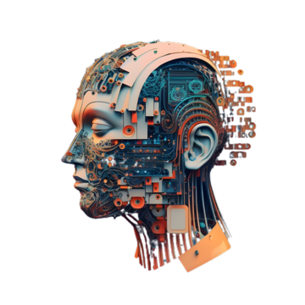
TOP NEW TECHNOLOGIES IN AI -Innovations Shaping the Future
Sahal Muhammed k k
NSTI Calicut

Slide 2
What Is AI ?
Artificial Intelligence (AI) refers to the simulation of human intelligence in machines designed to think and act like humans. These systems are capable of learning from experience, understanding natural language, recognizing patterns, and making decisions. AI encompasses a variety of subfields, including machine learning, natural language processing, computer vision, and robotics.

Slide 3
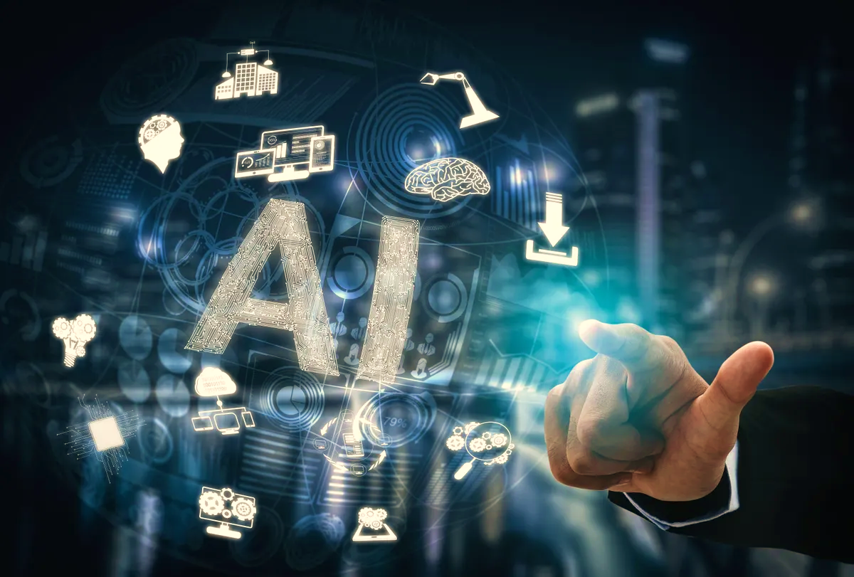
Impacts of AI
Artificial Intelligence (AI) is revolutionizing various sectors by boosting efficiency, accuracy, and decision-making. In healthcare, it enables early diagnostics and personalized treatments. AI powers autonomous vehicles and optimizes traffic in transportation, enhances fraud detection and investment strategies in finance, and personalizes shopping in retail. It also improves manufacturing through predictive maintenance and automation. While AI drives economic growth and innovation, it also raises ethical concerns like bias, privacy, and transparency, highlighting the need for responsible implementation.

Slide 4
How Artificial Intelligence Works
Today, AI applications use advanced machine learning algorithms and vast computational power to process and analyze data, mimicking human cognition like pattern recognition and inductive reasoning.
Developing an AI model begins with data acquisition, determined by the AI’s intended function. For instance, an image recognition model needs a large dataset of digital images.
Once collected, data scientists choose or develop algorithms to analyze the data. These algorithms instruct the computer on data processing to generate outputs. Many machine learning algorithms, including deep learning, are iterative. They process data, make predictions, receive feedback, and adjust their processes to improve over time, a method known as machine learning (ML).

Slide 5
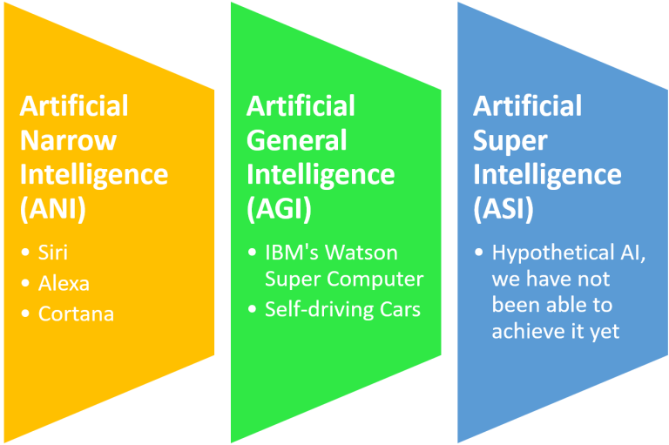
TYPES OF ARTIFICIAL INTELLIGENCE BASED ON CAPABILITY

Slide 6
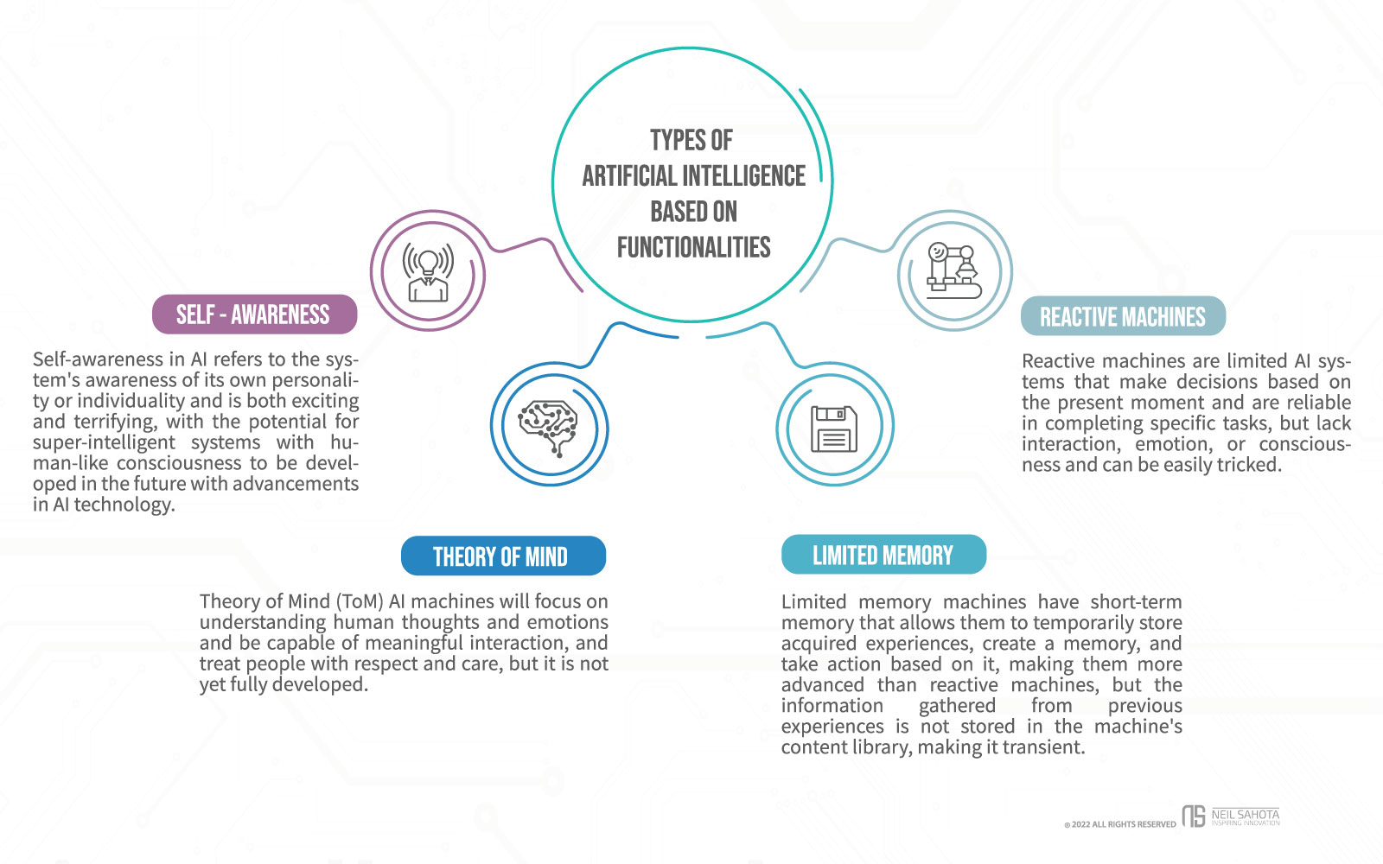
TYPES OF ARTIFICIAL INTELLIGENCE BASED ON CAPABILITY

Slide 7
Emerging Artificial Intelligence Technologies
Robotic Process Automation (RPA)
Robotic Process Automation (RPA) is an AI technology enabling software bots to interpret and handle data, performing tasks like data entry, extraction, and transaction processing.
Speech Recognition
Speech recognition, a crucial AI subset, enables computers to understand and respond to verbal commands by analyzing audio signals. Examples include Amazon Alexa and Siri, which allow users to set reminders, play songs, and search the internet using natural language.

Slide 8
Machine Learning Platforms
Machine learning develops algorithms for computers to learn patterns and make decisions. Used in forecasting, fraud detection, and business operations, it's impactful in healthcare for analyzing images and predicting outcomes, and in e-commerce for understanding customer behavior.
Natural Language Processing (NLP)
Natural Language Processing (NLP) enables computers to understand, interpret, and generate text and speech. This AI technology helps businesses efficiently process large amounts of unstructured data, leading to better decision-making and streamlined operations.

Slide 9
Cyber Defense
Cyber defense protects computer systems, data, and networks from unauthorized access and attacks. In the first half of 2022, there were 236.1 million ransomware attacks globally. AI and machine learning are crucial in this field, helping businesses detect anomalies and automate responses, thereby enhancing security measures.
AI-Optimized Hardware
AI-optimized hardware is specialized for efficiently executing AI and machine learning tasks. It includes CPU, GPU, FPGA, and ASIC components. The global market for this hardware is expected to grow by 10-15% by 2025. Popular applications include training deep learning models and image/video processing tasks like object detection and facial recognition.

Slide 10
Thank You ……..

